Slide 1
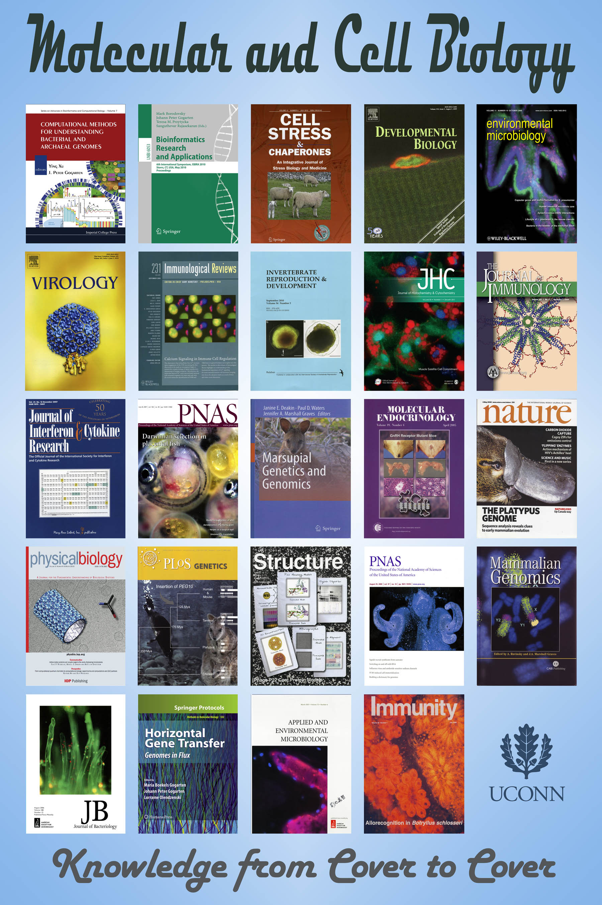

2021
Grad Orientation

Slide 2
Before we get Started:
Information for Activating Proximity Cards
Please make sure you have picked up your Student ID card from Card Services. These cards will begin working right away for key card access.
If you have any concerns or need to request additional access, please send an email with your name, Net ID, and access requested to Chelsea Bartos at
Chelsea.Bartos@uconn.edu

Slide 3
Welcome to MCB
You are now entering a graduate program in the Department of Molecular and Cell Biology.
We are a strong, successful department that covers a range of research interests and takes pride in training our students.
For the Ph.D. and the thesis Masters’ students you need to find a lab that meets your research interests and personality.
Don’t be shy, walk up or e-mail and meet the faculty, students and postdoc of the labs.

Slide 4
Get to know the faculty, students, staff and resources
Dr. Carol Teschke, Interim Dept. Head (Fall 2021)
Dr. Michael Lynes, Department Head
Dr. Spencer Nyholm, Interim Assoc. Dept. Head (undergrad education)
Dr. Joerg Graf, Assoc. Dept. Head (graduate education)
Maggie McDonnell, Department Administrator
Chelsea Bartos, MCB Graduate Programs
Elaine Mirkin, PSM and PM Programs

Slide 5
Graduate programs in MCB
Doctoral Degree
MCB PhD
Cell and Developmental Biology
Genetics and Genomics
Microbiology
Structural Biology, Biochemistry & Biophysics
Master’s Degrees
MCB M.S. | MCB P.S.M. | MCB P.M.
Cell and Developmental Biology Genetics and Genomics Microbiology Biochemistry, Biophysics & Structural Biology | Applied Genetics Microbial Systems A Analysis | Applied Biochemistry and Cell Biology

Slide 6
Graduate Program in
Molecular and Cell Biology
Ph.D. and M.S.
Area of Concentration | Head of AOC
Biochemistry/Biophysics | Nathan Alder
Cell Biology | David Goldhamer
Genetics and Genomics | Mike O’Neill
Microbiology | Jonathan Klassen
Ph.D. students - Dr. Graf is the temporary 1st year advisor.
MCB M.S. students - Dr. Graf is the temporary 1st semester advisor.
PSM students - their Program Director is the advisor.
Students can move freely between the different AOC.

Slide 7
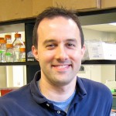
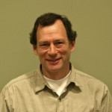
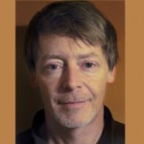
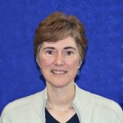
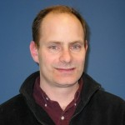
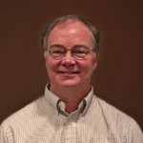
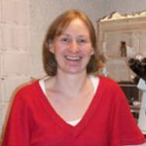
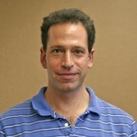
Cell & Developmental Biology
We study the molecular mechanisms underlying cellular processes including gene expression, proliferation and death, differentiation and development, cytoskeletal dynamics, membrane trafficking, signal transduction, and motility
Ken Campellone
Cytoskeletal dynamics
Autophagy & Apoptosis
Cellular bases of diseases
Dave Knecht
Cell motility
Chemotaxis
Actin binding proteins
Charles Giardina
Cell signaling
Gene regulation
Cancer biology
Juliet Lee
Cytoskeleton
Cell motility
Biomechanics
David Goldhamer
Developmental & regenerative biology
Stem cells and
Rare musculoskeletal diseases
(AOC Head)
Michael Lynes
Immunobiology
Immunotoxicology
Metallothionein function
Aoife Heaslip
Toxoplasma actin cytoskeleton
Host-pathogen interactions
Transport and secretion
Adam Zweifach
Immune cell signaling
Discovery of new
immunomodulatory molecules
cellbiology.uconn.edu

Slide 8
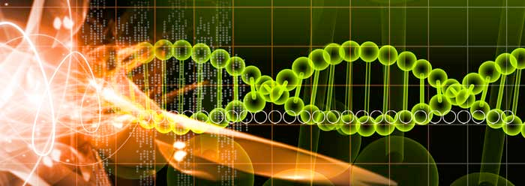
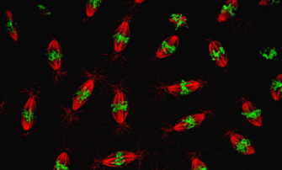
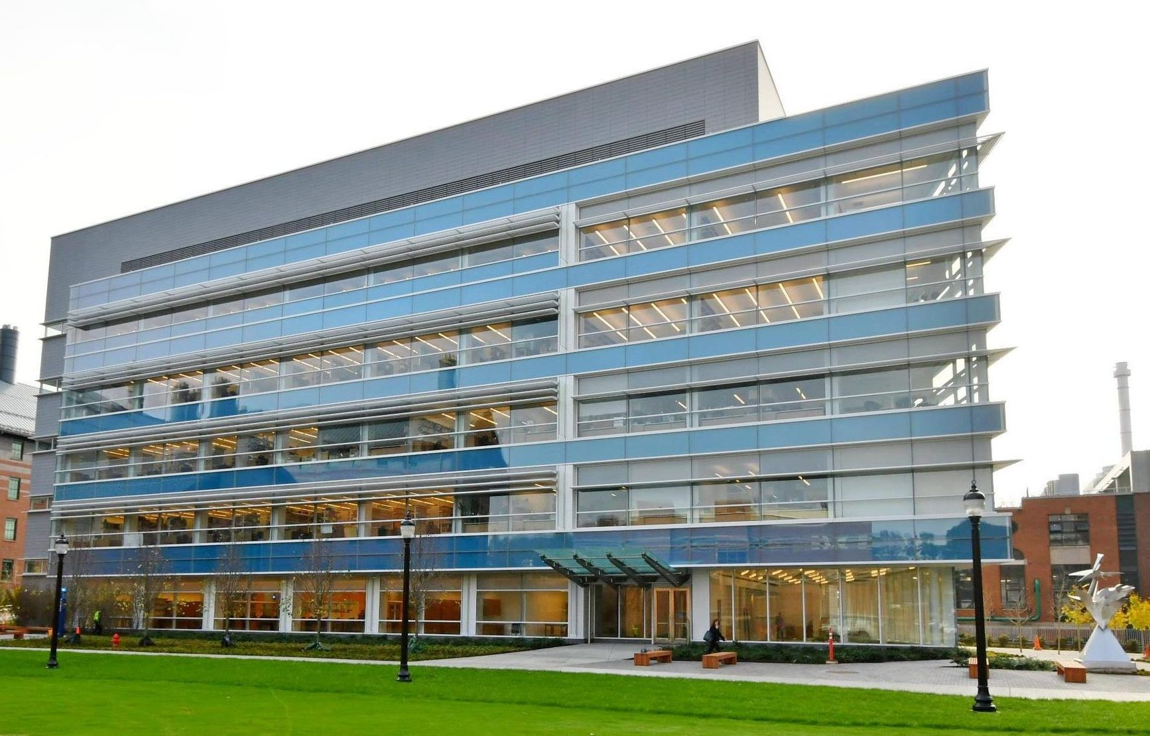
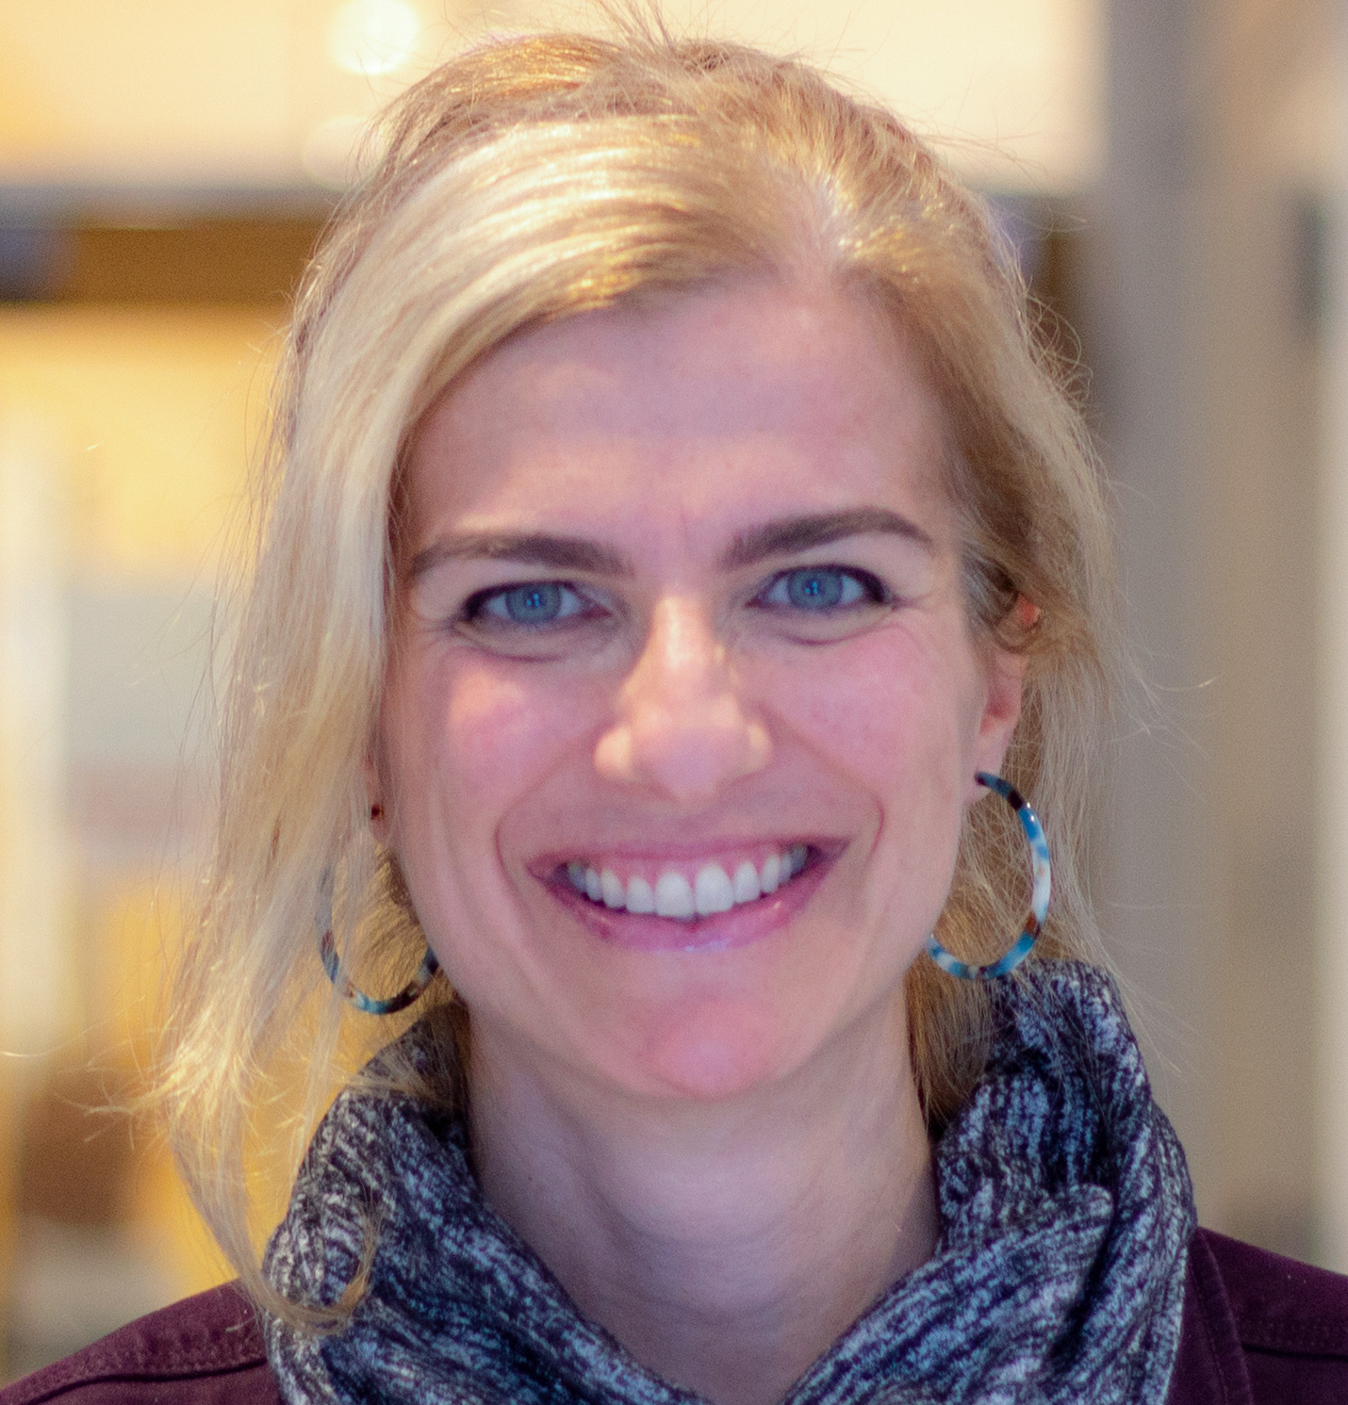
Genetics and Genomics
Genome Regulation, Structure & Evolution
Leighton Core
Craig Nelson
Jelena Erceg
Spring 2021
Rachel O’Neill
Engineering and Science Building
Stacey Hanlon
Spring 2021
Mike O’Neill
(AOC Head)
genetics.uconn.edu
Barbara Mellone
Ping Zhang

Slide 9
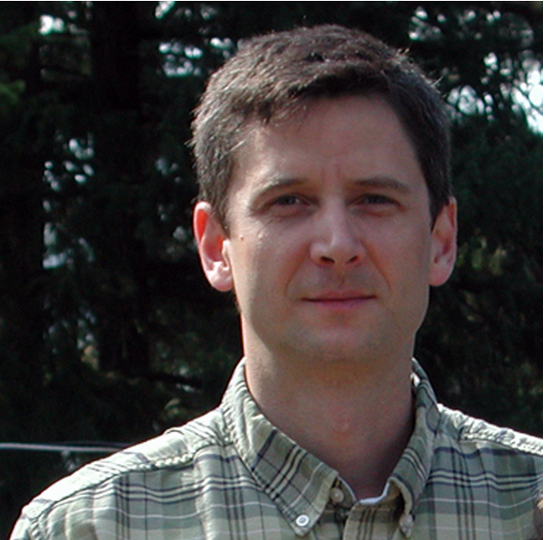
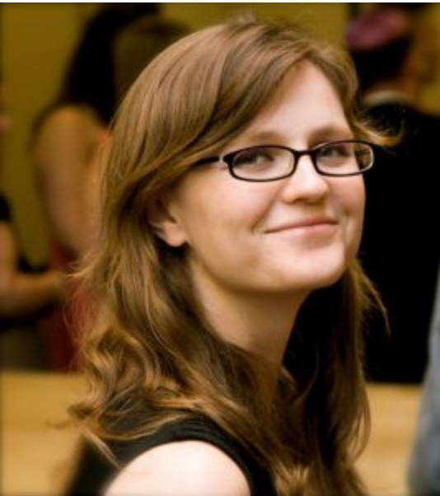
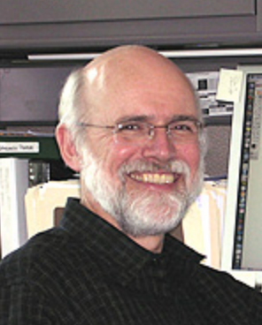
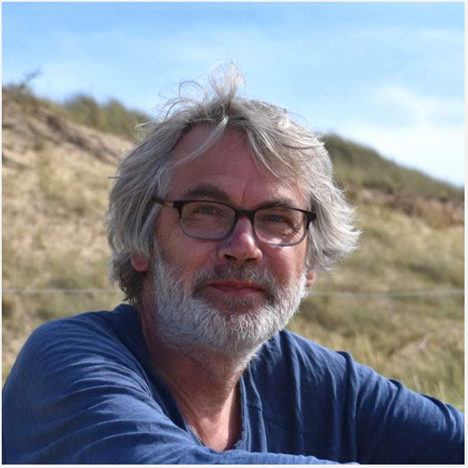
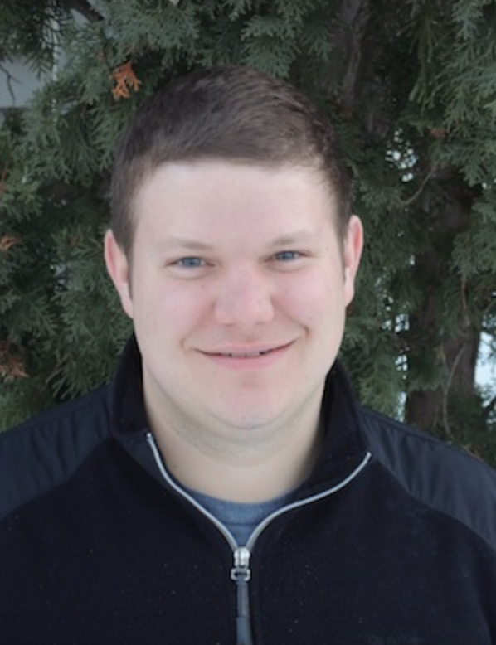
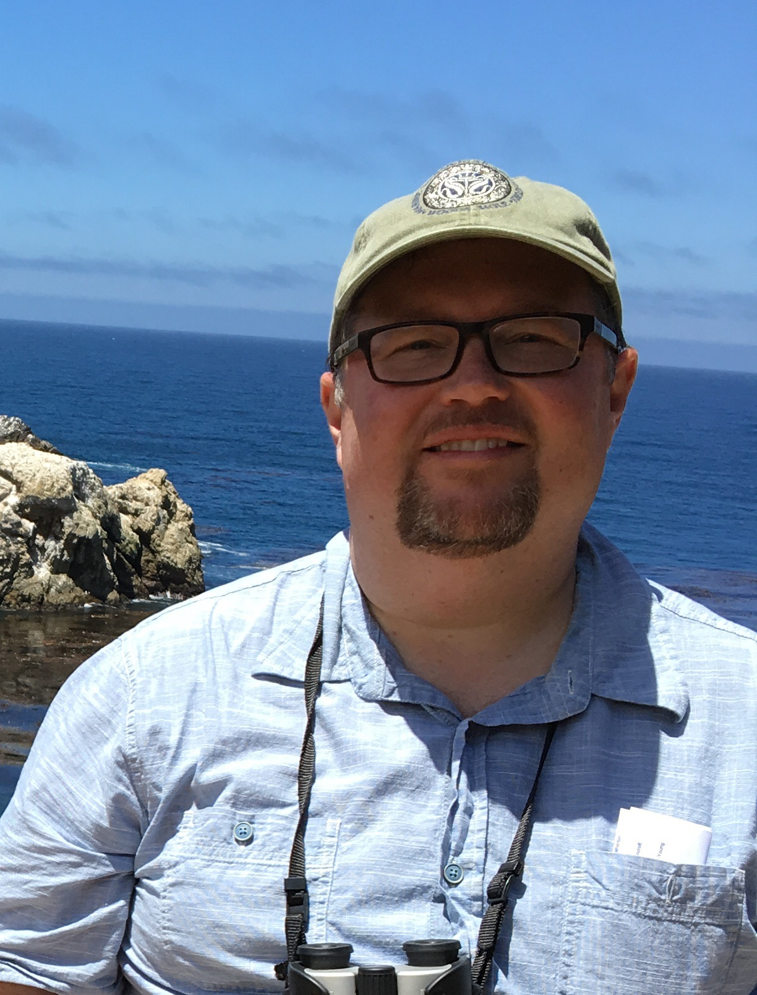
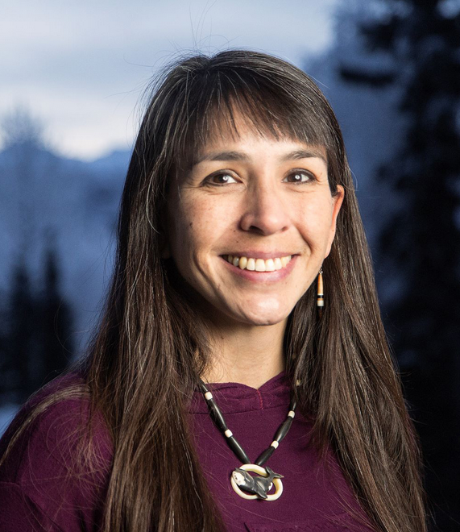
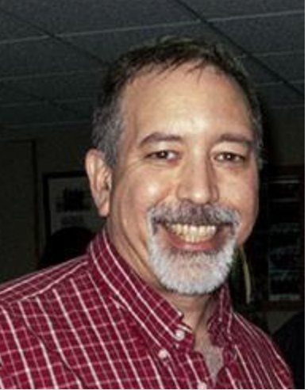
Microbiology
We offer broad training in microbiology with a focus on microbiomes, symbiosis, evolution, ecology, genomics, and phylogeography.
Dan Gage
- Signaling in
microbial symbioses
- Microbial functions
in complex
environments
- Protist biology
Sarah Hird
-Host-microbe evolution
-Microbial phylogeography
-Bioinformatics
Ken Noll
- Thermophiles
- Microbial physiology
Peter Gogarten
- Gene transfer
- Selfish genes
- Molecular evolution
- Early evolution
of life
Jonathan Klassen
-Fungus-growing ants
-Defensive symbiosis
-Microbiome function
Spencer Nyholm
- Marine symbioses
- Innate immunity
- Defensive symbiosis
Joerg Graf
- Host-microbe
interactions
- Bacterial genomics
- Experimental
evolution
- Antibiotic resistance
- Biofilms
Kat Milligan-Myhre
-Host-microbe interactions
-Population variation in
microbiota interactions
-Gut microbiota
Thane Papke
-Haloarchaea
-Microbial community
structure and function
-Prokaryotic speciation
https://microbiology.uconn.edu/

Slide 10
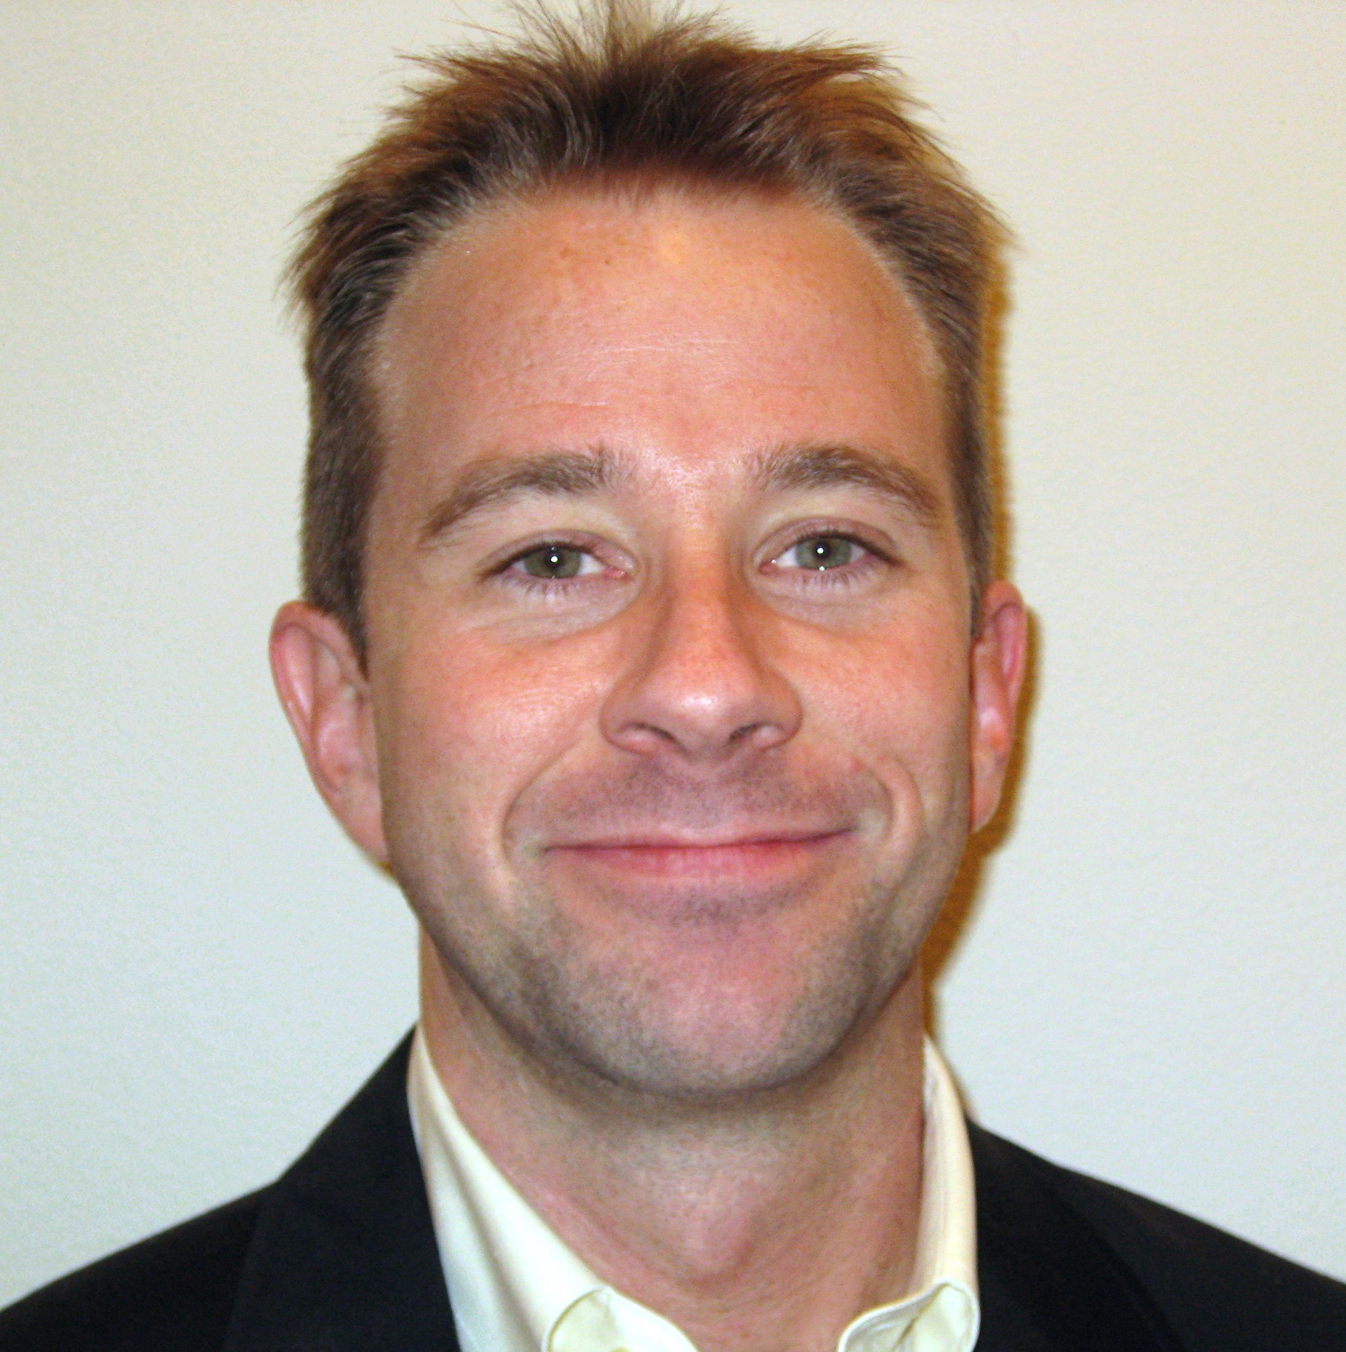
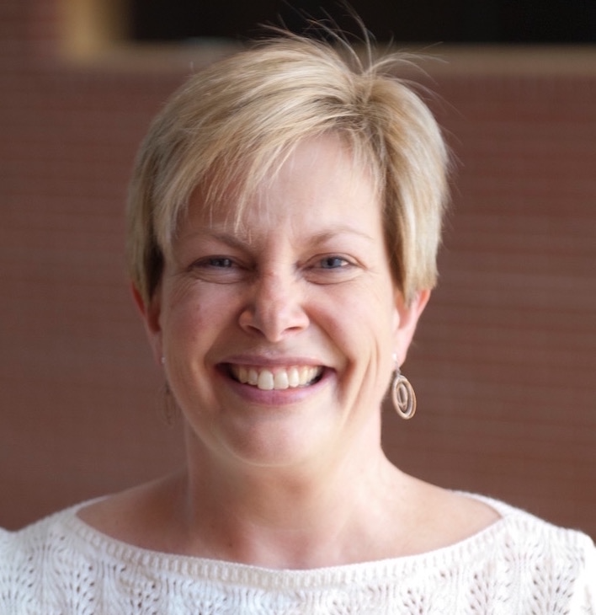
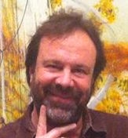
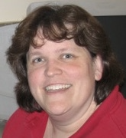

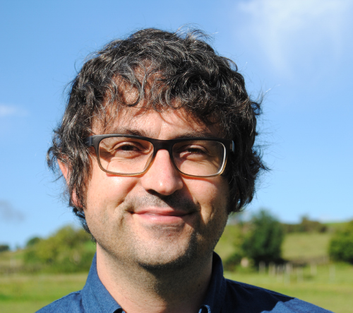
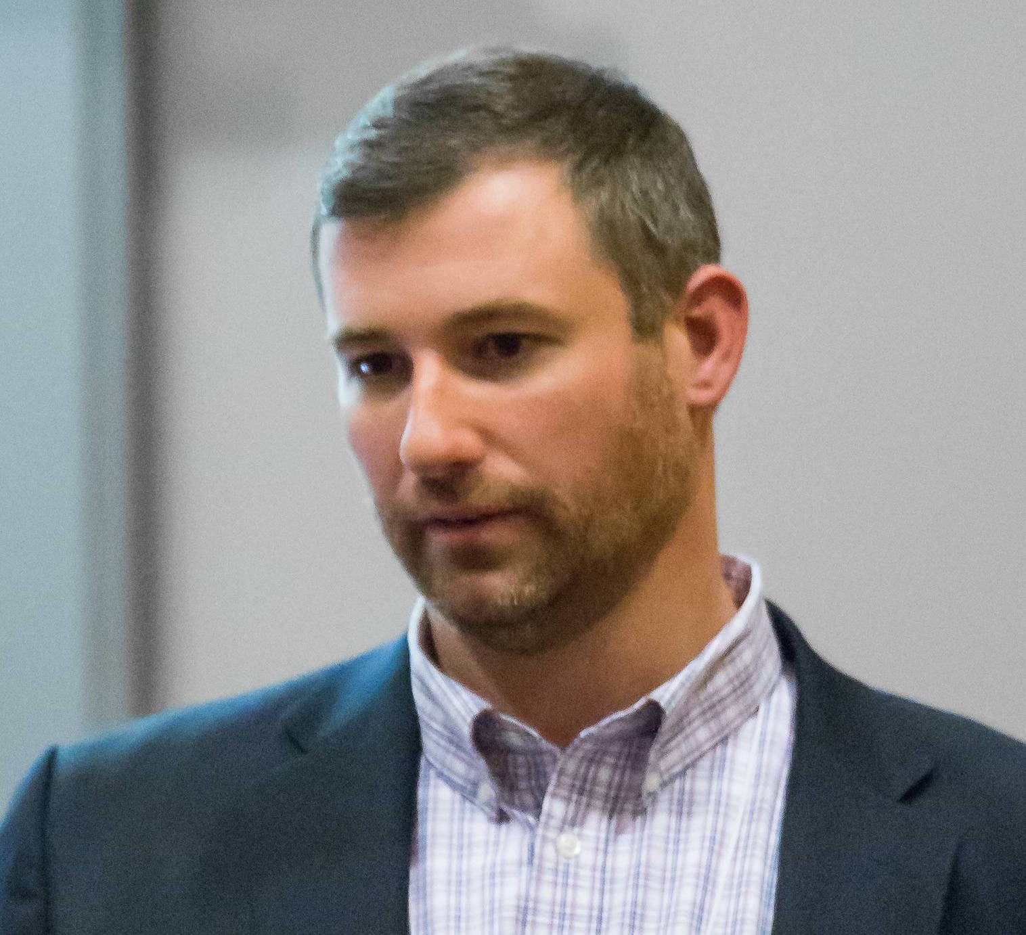
Structural Biology, Biochemistry & Biophysics (SB3)
Spectroscopic and structural techniques to
study mitochondrial protein complexes
Membrane biophysics
Mitochondria-targeted drugs and mechanisms
of action
Genetic and biochemical analyses to study dsDNA virus assembly
Evolution of viral protein structures
Conformational changes attendant with virus assembly using single molecule fluorescence
Nathan Alder
Carolyn Teschke
NMR-based approaches to study protein
structure and evolution
Role of amyloids in disease
Phage/virus proteins and use in
nanotechnology
Protein structural analysis using x-ray
crystallography
Regulation of protein biogenesis during stress and ribosome structure-function relationships
Targeted antimicrobial drug delivery
Andrei Alexandrescu
Victoria Robinson
Molecular interactions using structural,
biochemical and biophysical approaches
Mechanisms of PKR activation in the
innate immunity pathway
Development of antiviral agents
Cryo-EM, cell biology and single molecule Biophysics approaches to study virus-host cell interactions
Biogeneisis of viral particles
Discovery of novel targets for antiviral drugs
James Cole
Simon White
Computational methods to study
biomolecular structures
Virus cell entry mechanisms
Membrane biophysics and mitochondria
morphology
sb3.uconn.edu
Eric May

Slide 11

Department of
Molecular and Cell Biology
119 MCB Graduate Students
89 PhD Students
44 Faculty Members
6 Postdoctoral fellows
Research labs are in 4 buildings
~100 Publications published each year
Newly funded grants: ~$10.8 million
Last year’s Total Expenditure Research Grants $6,119,146

Slide 12
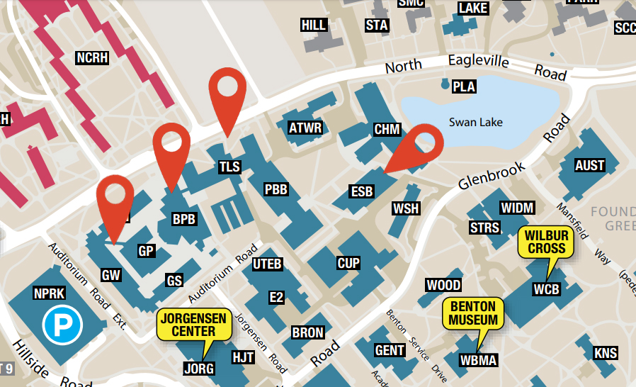
Where we are
Torrey Life Sciences (TLS)
Biology and Physics (BPB)
Engineering and Science (ESB)
GANT Science Complex

Slide 13
How to find out more?
http://mcb.uconn.edu
@Uconnmcb
http://gomcb.rso.uconn.edu/
http://grad.uconn.edu/a-scholars-life/graduate-student-advocacy/
http://ehs.uconn.edu

Slide 14
Safety Training
Go to Husky SMS
https://ehs.uconn.edu/huskysms/
WebEx training: Chemical Safety Training
Biosafety General (Online)
Radiation Safety Initial for Non-Users (Online) you can do this once you know if your PI requires this.

Slide 15


Slide 16
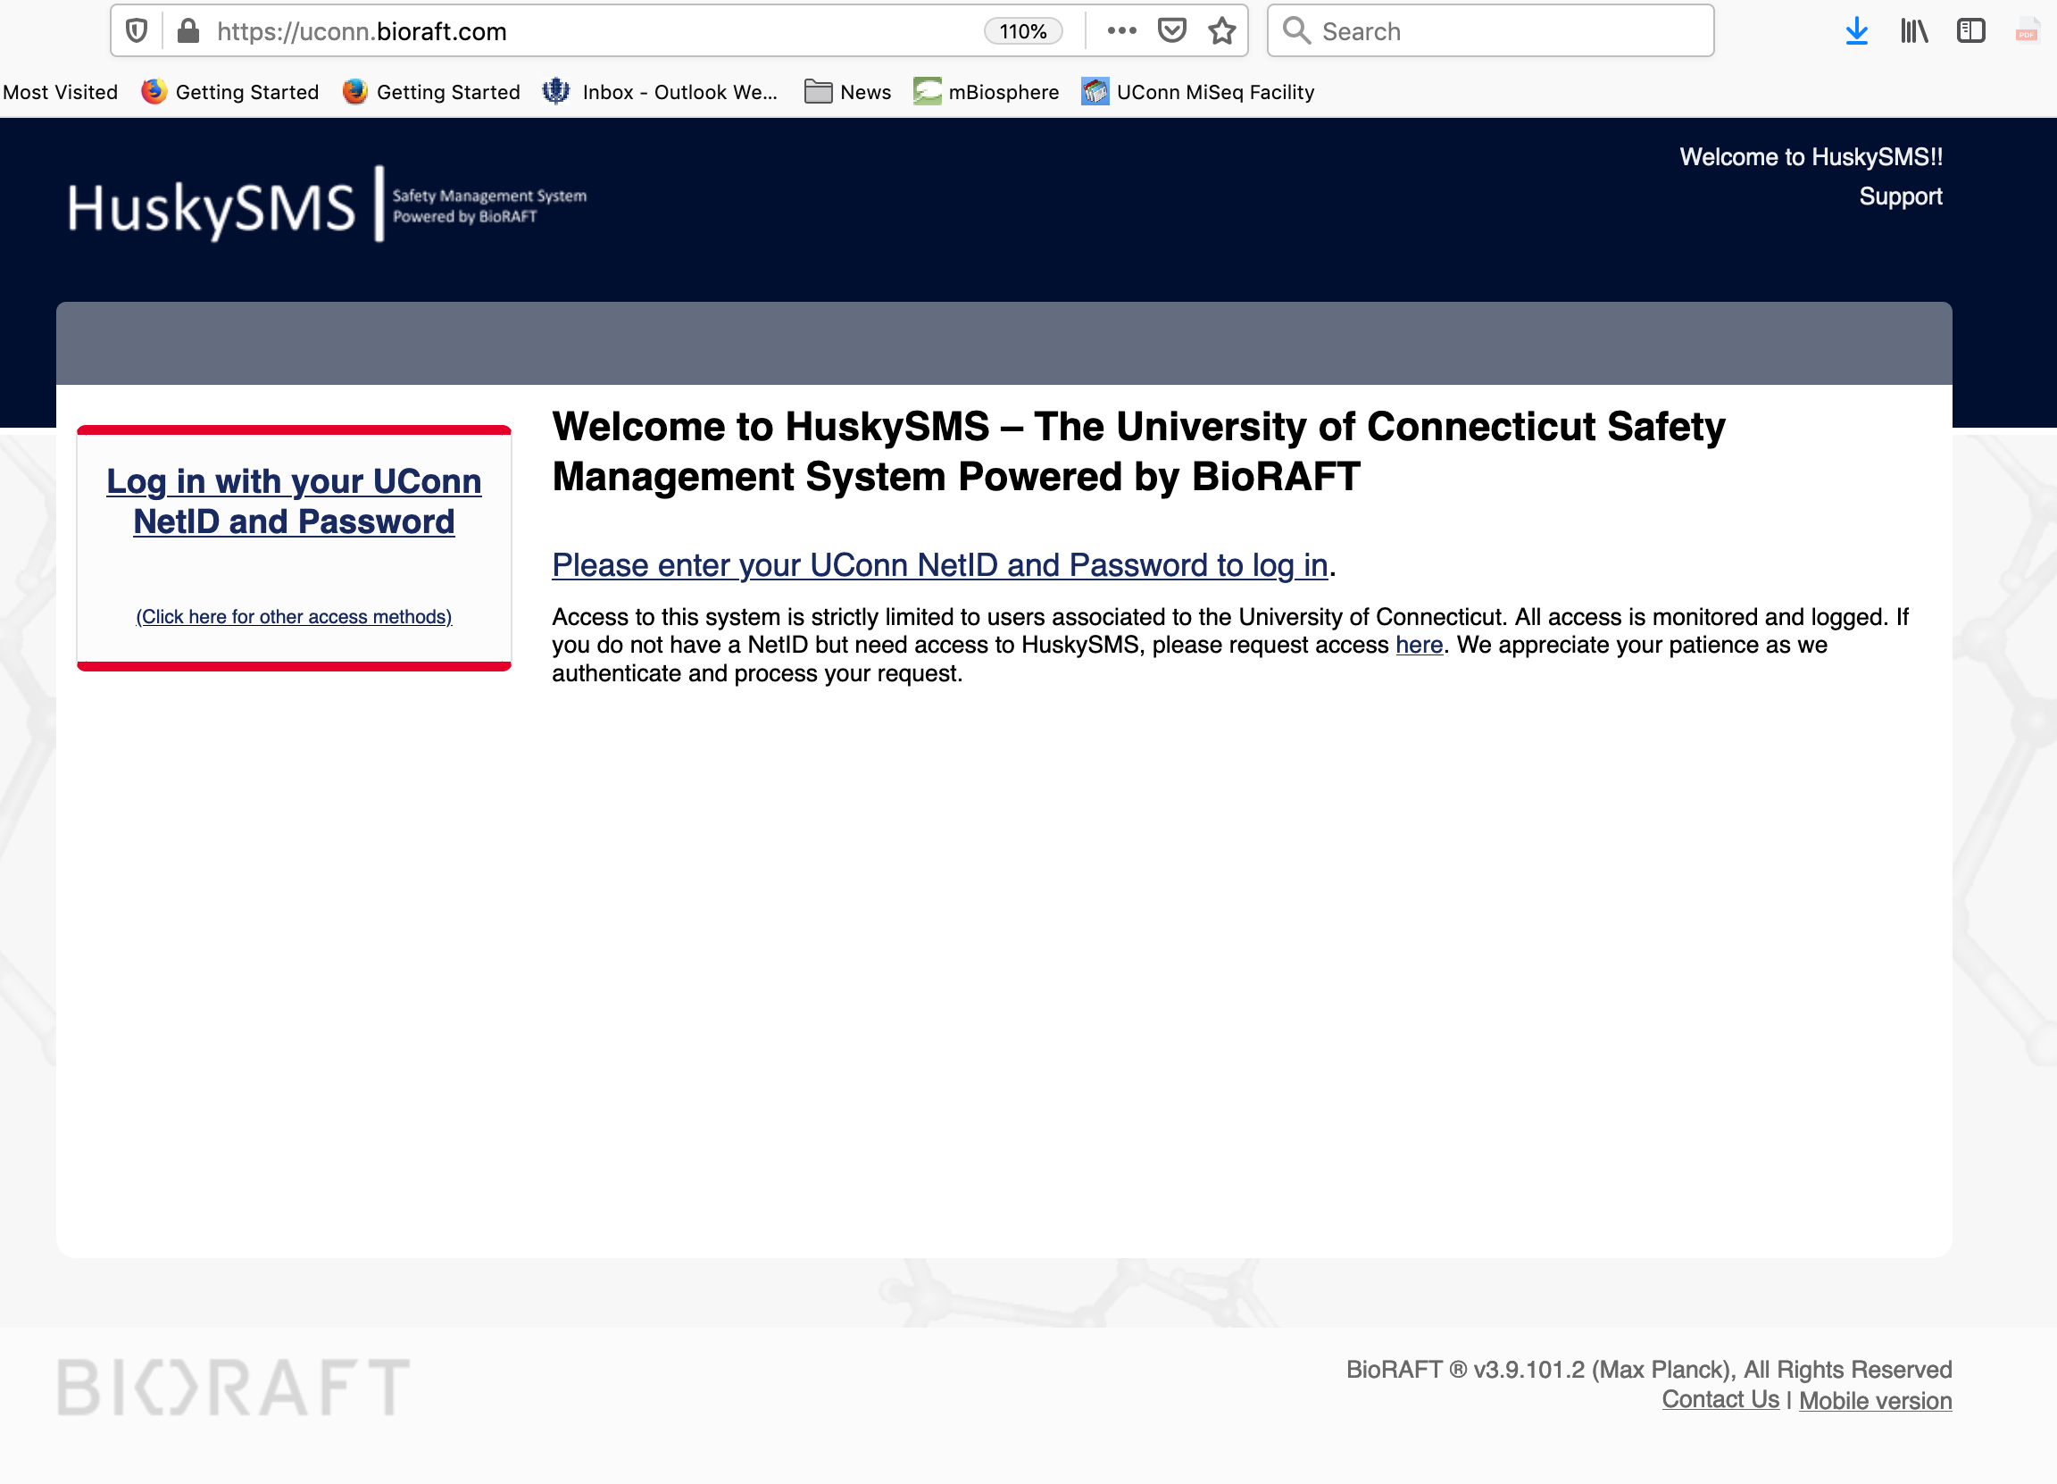

Slide 17
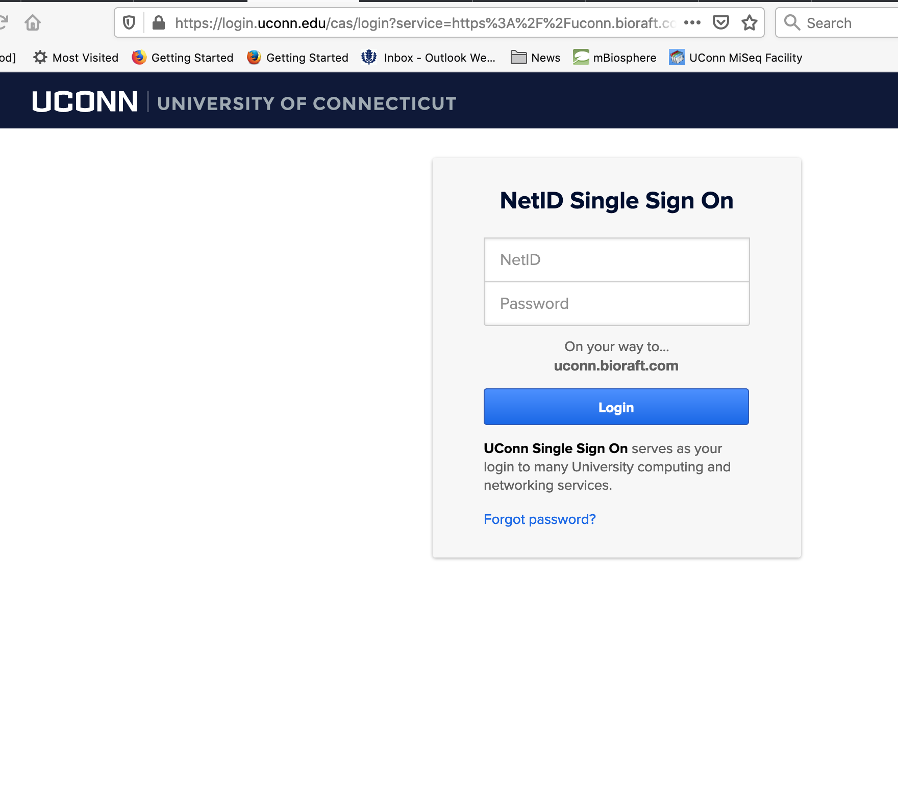

Slide 18
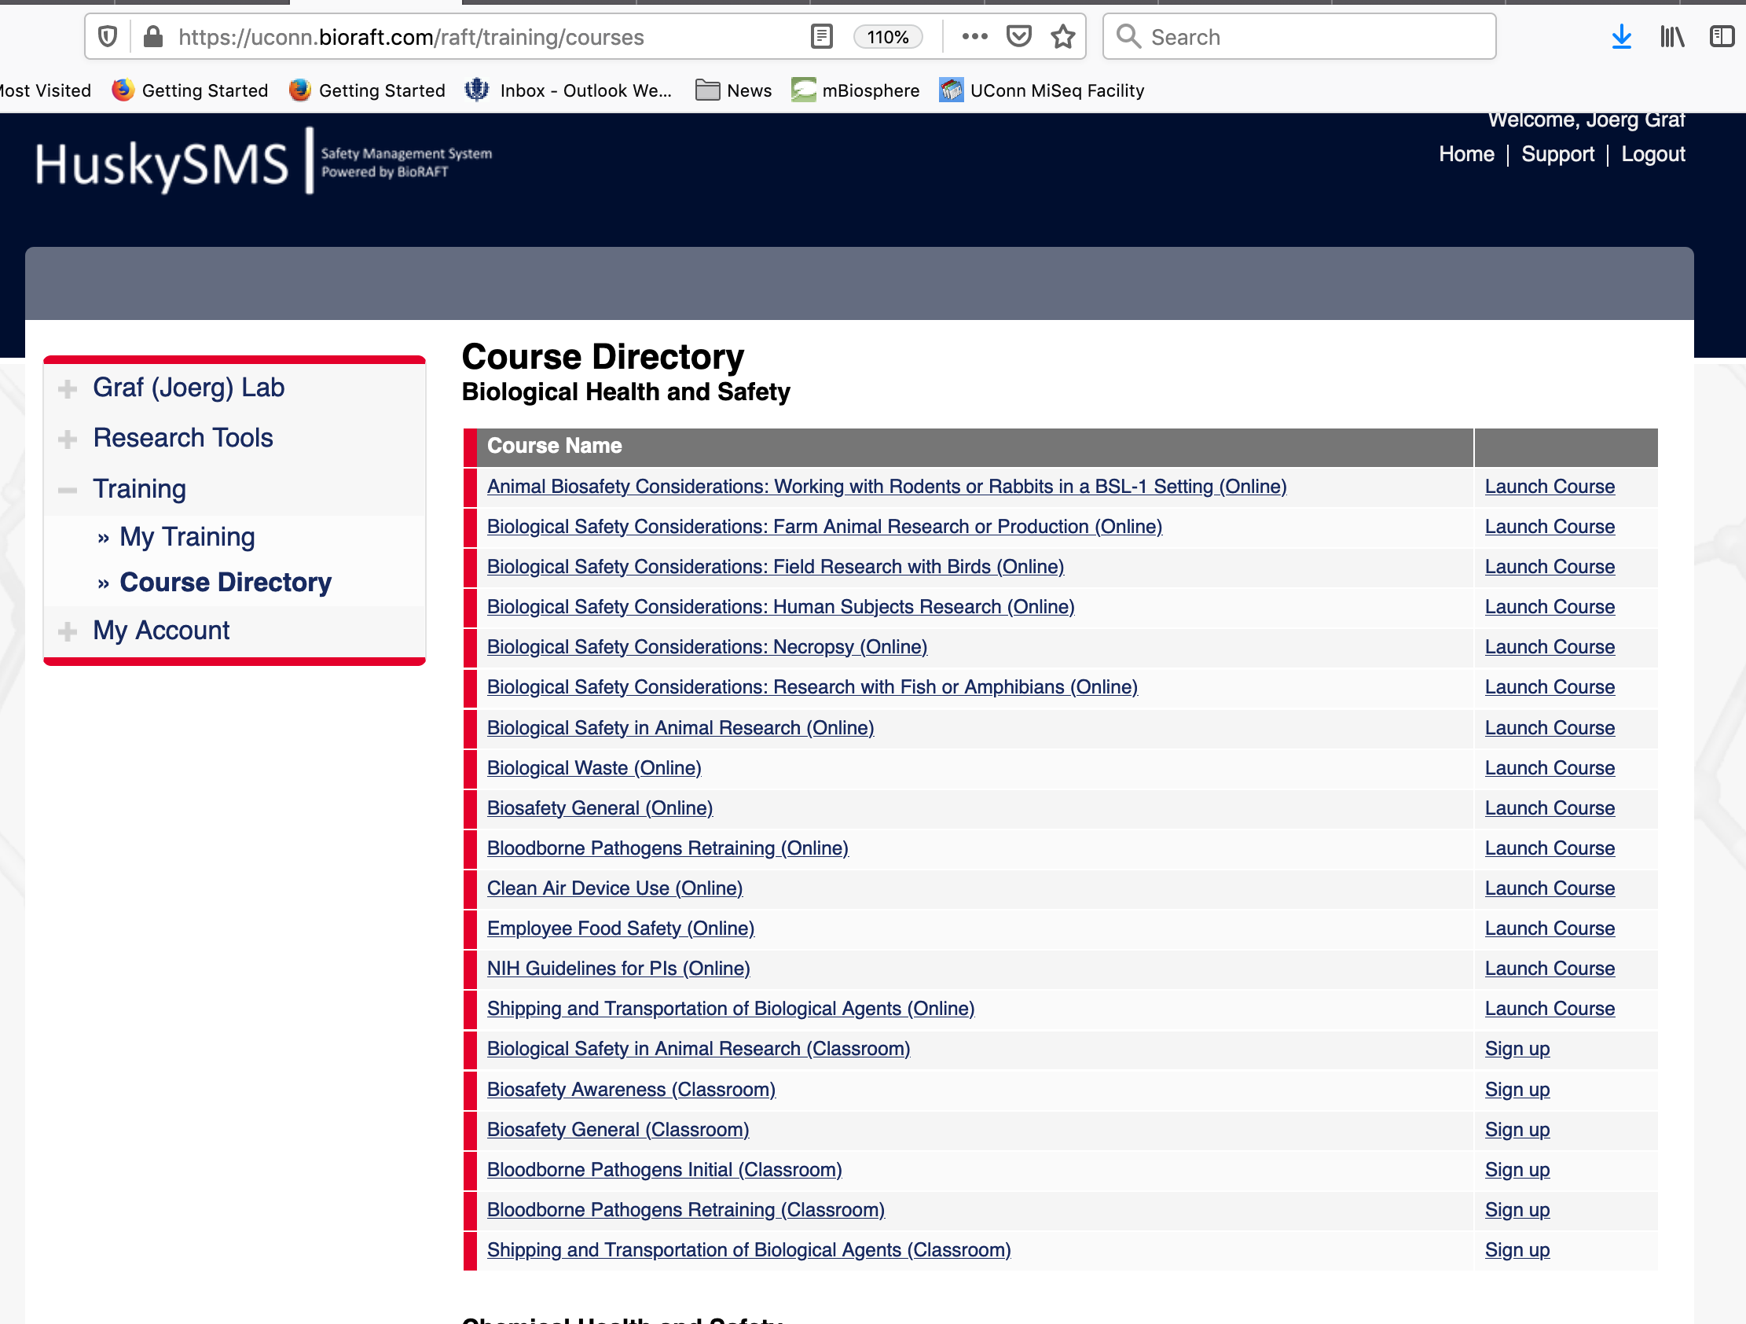

Slide 19
General Expectations
Tuesdays 3:30 p.m. Departmental Seminar
Fridays 12:20 p.m. Graduate Seminar (MCB 5884)
Journal clubs in different fields
Do not plagiarize.

Slide 20
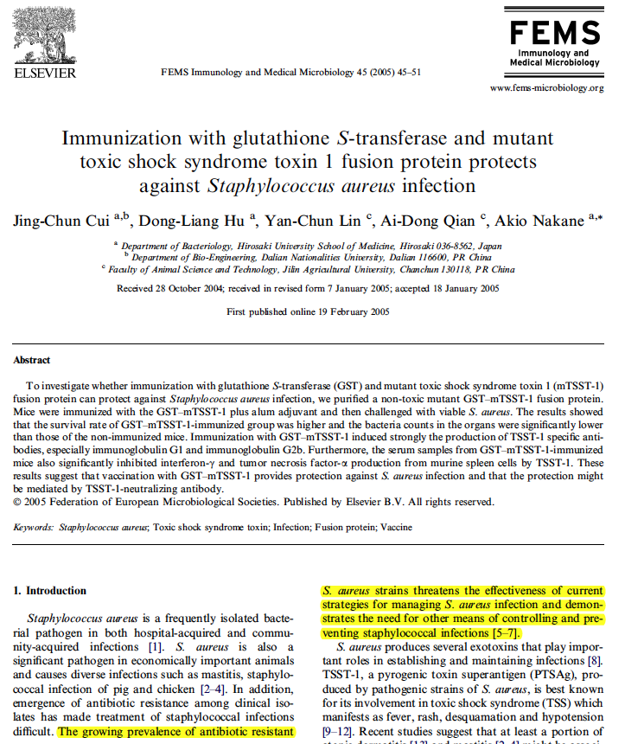
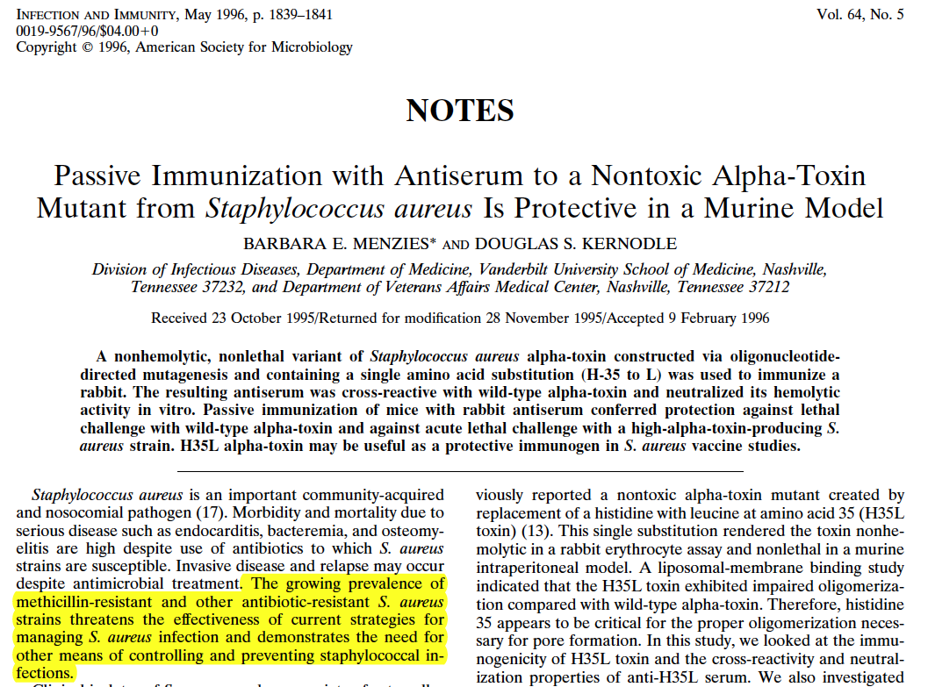

Slide 21
Molecular & Cell Biology Ph.D. Program – First Year Course Registration
MCB 6000:
Rotations in MCB Laboratories
(Graf - 3 Credits)
MCB 6001:
MCB Intro to MCB Research
(Robinson- 3 Credits)
MCB 5884:
Research in Progress
(Robinson - 1 Credit)
MCB 6002:
Introduction to MCB Faculty Research
(Zhang - 1 Credits)
Fall Semester Courses
MCB 5801:
Scientific Writing and Project Development
(Klassen -2 Credits)
MCB 5910:
Responsible Conduct in Research
(Daggett-1 Credit)
Discuss additional credits with your 1st Year Advisor – Dr. Graf
MCB 5884:
Research in Progress
(Robinson–1 credit)
Spring Semester Courses

Slide 22
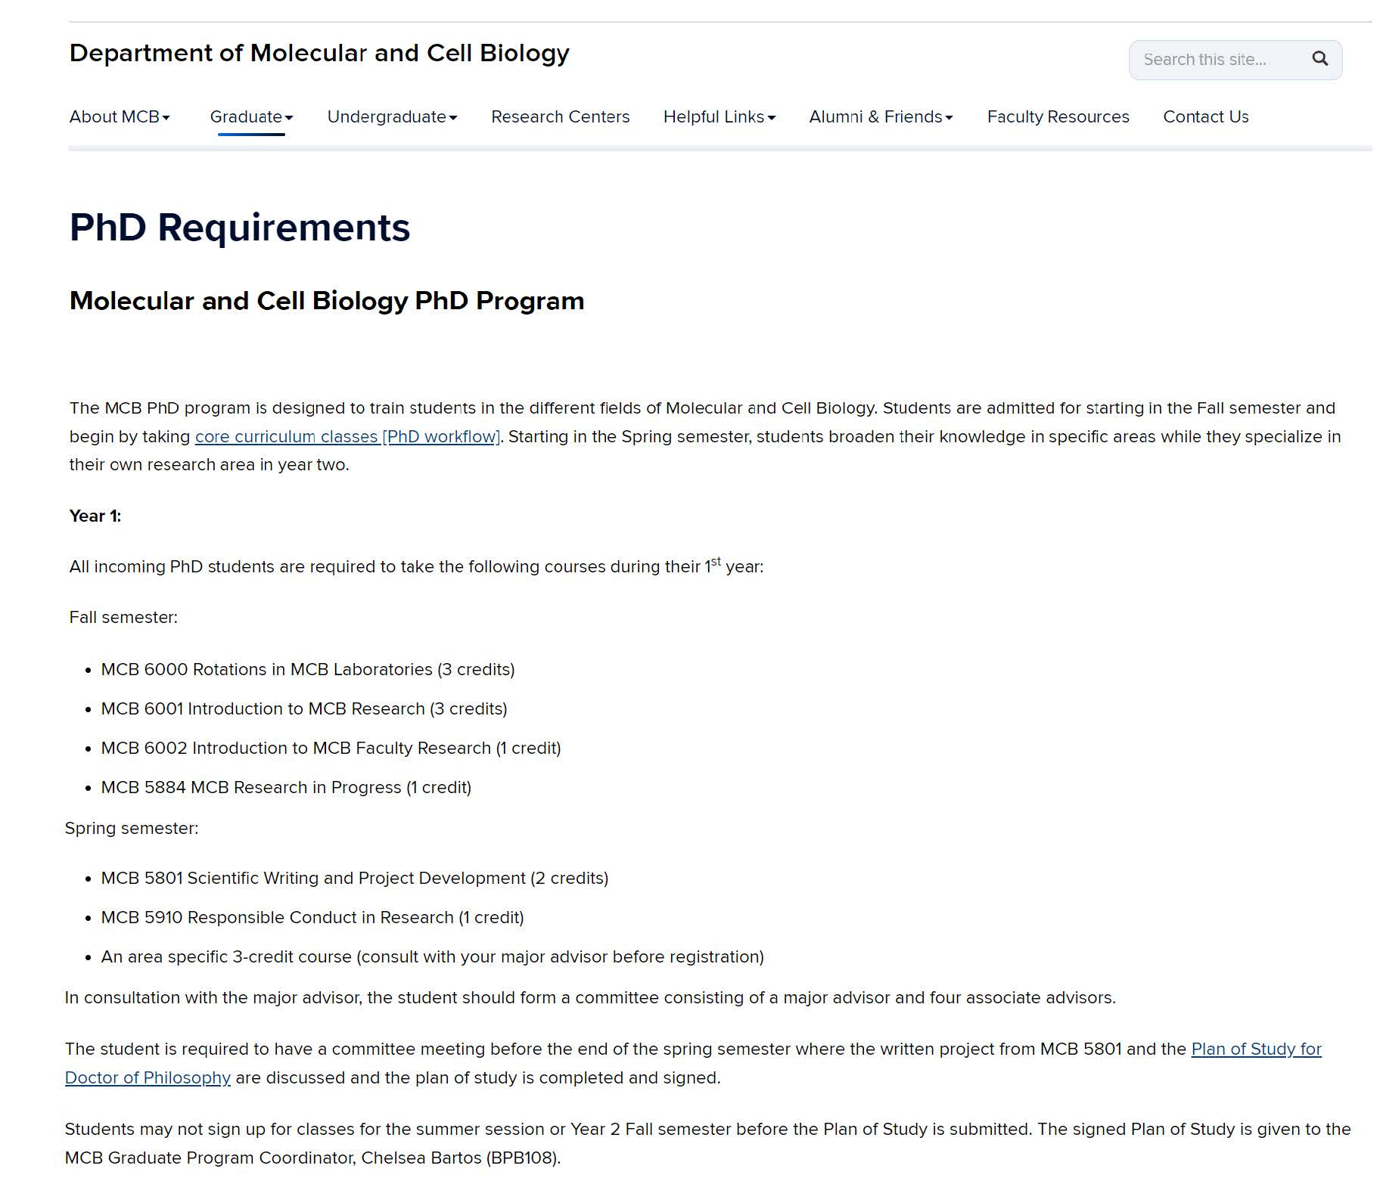
Lots of information is available on the website

Slide 23
Info for PhD students
Rotations:
Spend time in your research lab!
Contact faculty members before choosing rotations.
This is your chance to get to know the PI and the lab and for them to get to know you.

Slide 24
Info for PhD Students
Spring semester:
Organize your 4th rotation in early January and find your new major advisor!
Student form a committee consisting of a major advisor and four associate advisors.
Submit a change of advisor form to Chelsea Bartos , MCB Graduate Coordinator
(BPB108)
Have a committee meeting before the end of the spring semester where the written project from MCB 5801 is discussed and the Plan of Study for Doctor of Philosophy is signed.
Students may not sign up for classes before the Plan of Study is submitted.
The signed Plan of Study is given to Chelsea Bartos, MCB Graduate Coordinator (BPB108)

Slide 25
Molecular & Cell Biology MS Program – Suggested Course Registration
Plan A: Thesis Master’s
MCB 5884:
MCB Research in Progress
(Robinson – 1 Credit)
Plan B: Non-thesis Master’s
MCB 5884:
MCB Research in Progress
(Robinson – 1 Credit)
MCB 6001:
MCB Intro to MCB Research
(Robinson – 3 Credits)
Both Plan A & Plan B may add additional courses outlined below as discussed with Advisor
MCB 6002:
Introduction to MCB Faculty Research
(Zhang – 1 Credits)
Cell & Developmental Biology
MCB 5217
Genetics & Genomics
MCB 5217 OR MCB 5452
Structural Biology, Biochemistry and Biophysics (SB3)
MCB 5012
Microbiology
MCB 5699
MCB 5250
MCB 5621 OR MCB 5681
MCB 5099-339
MCB 5499
Additional Courses:

Slide 27
Info for Professional Science Master’s and Professional Master’s Students
For PSM students: 9/2 5-6 pm orientation
Dr. Giardina, Dr. Graf, Ms. Mirkin, and Dr. Robinson will talk about program requirements.

Slide 28
Departmental Seminars
Seminar in Biochemistry and Structural Biology
Seminar in Cell Biology
Seminar in Genetics
Seminar in Immunology
Seminar in Microbiology

Slide 29
What to do if things go wrong?
Speak to your mentor / lab supervisor
Speak to your AoC head
  David Goldhamer (Cell and Developmental)
  Jonathan Klassen (Microbiology)
  Nathan Alder (SB3)
  Mike O’Neill(Genetics and Genomics)
Speak Joerg Graf, Assoc. Dept of Graduate Res. & Edu
Speak to Dr. Carol Teschke, MCB Department Head
Contact the Graduate Student Ombudsmen
Speak to Dr. Spencer Nyholm, Assoc. Dept. Head
Speak to Chelsea Bartos, MCB Graduate Program Coordinator

Slide 30

Stop by today (with a mask while social distancing) or e-mail to introduce yourself to me and other faculty
My office (Joerg Graf) is BPB 409 but meeting will be by WebEx.

